Slide 1
Ising Model Variation by Quantum and Classical Methods
Spherical Qows
IQC 2026

Slide 2

Ising Complexity
Ferromagnetic, any field
Polynomial solutions: min-cut.
All ties > 0, so every node want to agree. No conflicting loops
Every Ising problem has exponentially many states, yet some are NP-Hard. 3 main types of models exist:
Frustration is what makes Ising problems hard. In this model, every ties is cooperative, so the problem is unfrustrated and solved by min-cut. If some industries competed, negative ties, the problem would become frustrated and finding its ground state is NP-hard in general. Frustration fills the energy landscape with many local minima with high barriers.
Planar, no field
Polynomial solutions: Pfaffians,
Higher dimensionality, Higher N
Frustrated, non-planar NP-hard
Mixed-sign loops make broken bonds. Higher edge per node count.

Slide 3
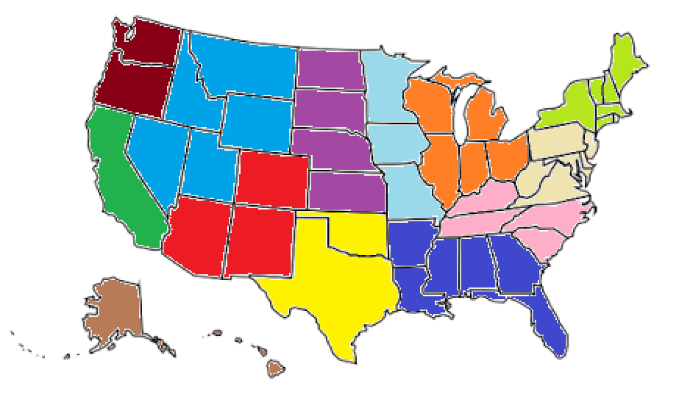
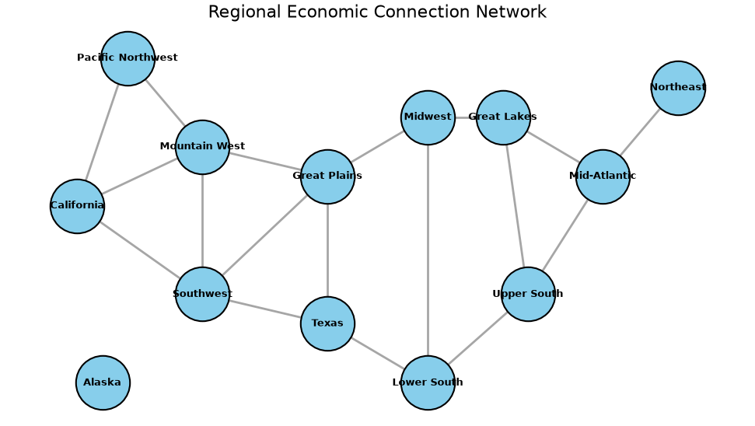
Regionalization
For regional modifiers, instead of choosing random numbers between -0.15 and 0.15 we based the modifier on political affiliation of the region
Negative values that mean a high likelihood of switching to digital were assigned to the more left leaning regions, and positive values to the right leaning regions
Random noise was included but when comparing two simulations it was set to the same random seed

Slide 4
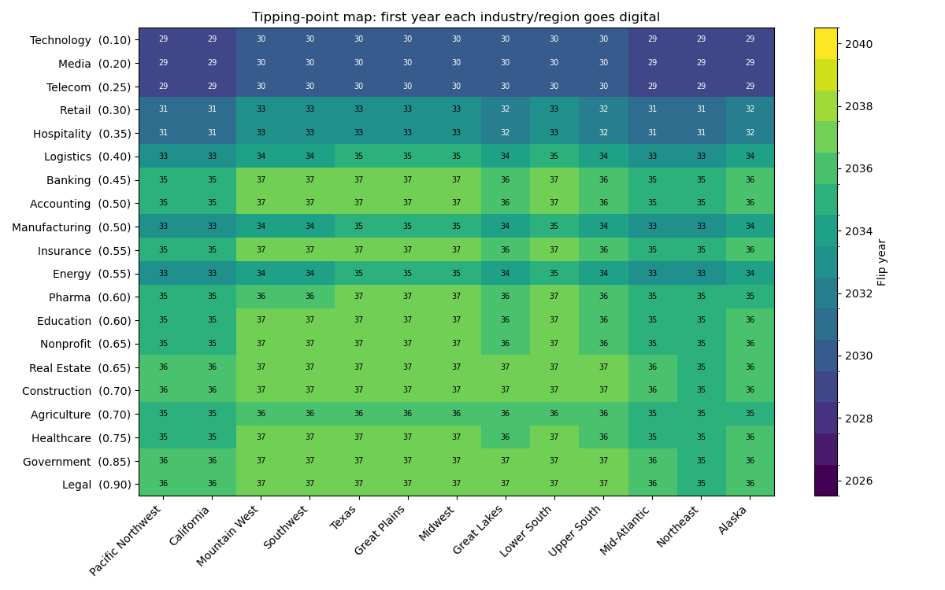
Classical Solution
The energy industry is tied to the manufacturing industry, which have mid level resistances so they have in between flip years
Banking is tied to legal and real estate which have higher resistances so banking is slowed

Slide 5
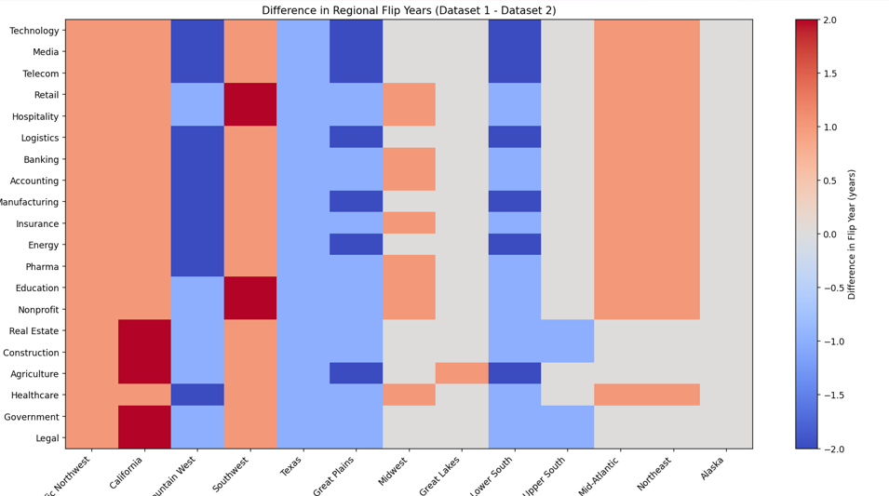
How Important are Regional Ties?

Slide 6
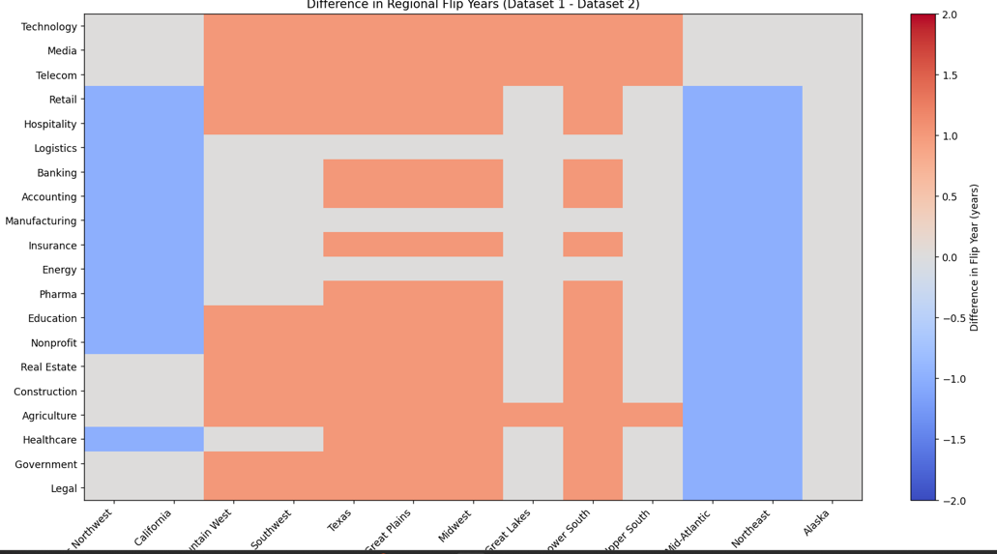
How Important are Regional Weights?

Slide 7
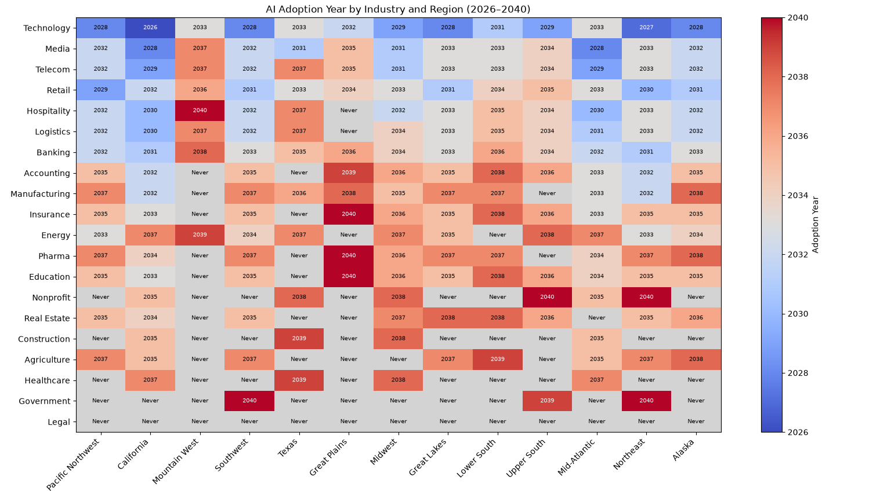
Quantum Simulation
Simulated annealing using D-Wave annealing simulators.
Large number of regions, 2²⁶⁰ configurations.
Did not accurately reproduce classical model.
Unable to test annealing on hardware due to paywall.

Slide 8
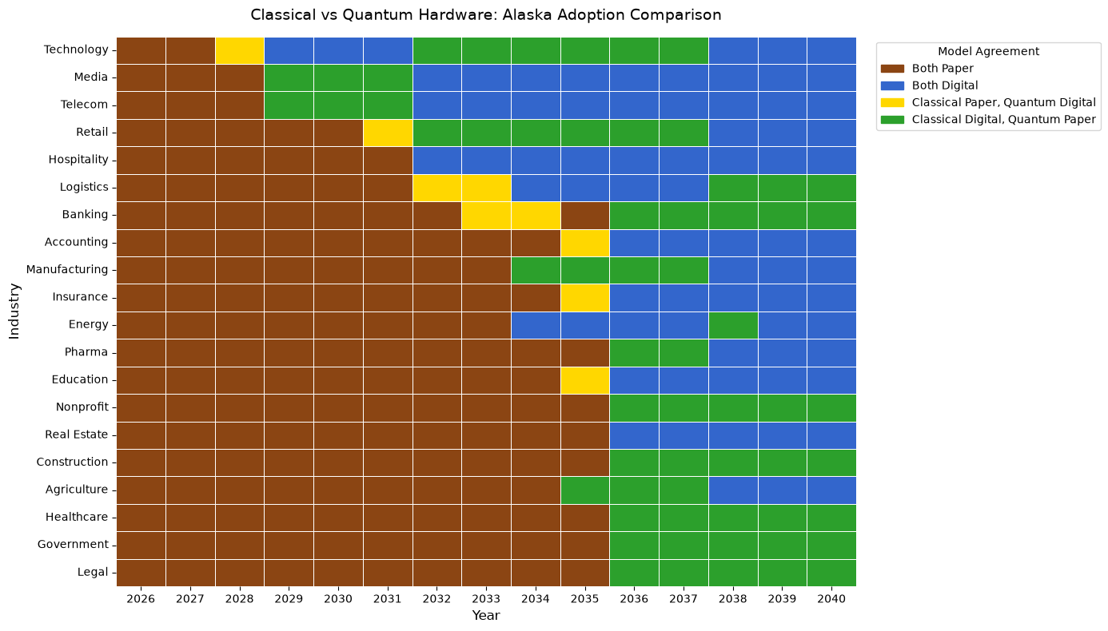
Quantum Simulation cont.
Result of single region (Alaska) compared to the classical prediction.
Substantially less configurations from the full region simulation.
Graph shows comparison between classical and quantum simulation.

Slide 9
Quantum hardware model
How it works
We implemented the Quantum Approximate Optimization Algorithm (QAOA) on Cepheus-1-108q though open quantum. We chose this one because we had access to hardware that could run it.
Due to costs (credits, time, etc) we were able to simulate only one region with the 20 industries
We compare this to our classical results for out benchmark region Alaska, which has no regional ties or weights.
The QAOA algorithm takes each node (each industry) as one qubit with the initial state of paper: |0>
Then two operations get repeatedly applied to the qubit:
  The first contains information about the problem, informing the model of how good its prediction is
  The second introduces quantum interference, developing probabilities for different answers and causing the states to be a linear combination of paper and digital states.
After a certain number of iterations, the physical qubits are measured collapsing the qubit to one particular choice of paper and digital

Slide 10
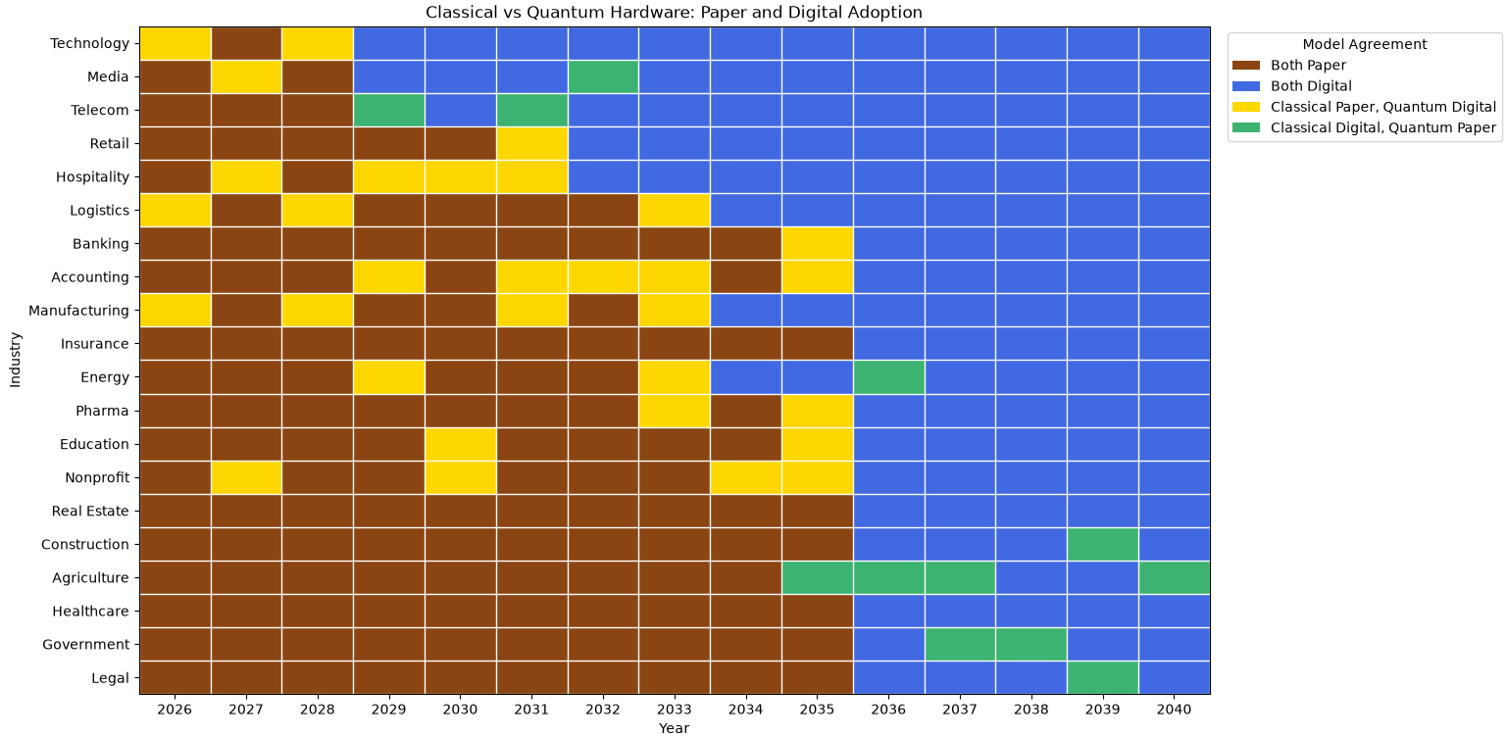
Quantum hardware results

Slide 11
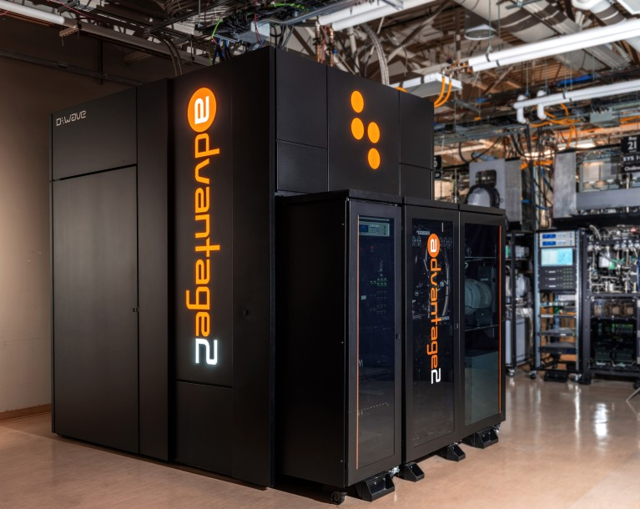
Future Research Possibilities
Refine data
  Utilize public facing data to feed into economic models for J_{ij}, r_{i}, A(t), and R_{region}
Model different scenarios
  Increase number of nodes to compare performance between classical and quantum computing
Run the annealing process on quantum hardware
Notes:
Public Facing Websites:
Coupling: Bureau of Economic Analysis (BEA)
look for: Use tables by industry
feed into the input-output (Leontif) coefficient equation
Resistive index
Regulatory: www.ecfr.gov (Electronic Code of Federal Regulations)
Technological: www.bls.gov (Bureau of Labor Statistics)

